Slide 1

Going Paperless
Presented By :-
1)Aniket Prajapati - 44
2)Parth Baraiya - 05
3)Aman Rai - 46
4)Anmol Kaur Saggu - 49
5)Akhilesh Kumar - 99
6)Karan Prajapati – 97
7)Rahim Khan - 21

Slide 2
INTRODUCTION
Concept introduced in the 1980s.
Office of the Future, one that requires little or no paper to do business.
Instead of paper, the paperless office would use modern technology to accomplish all of the same goals.
Going Paperless can make documentation and Information sharing easier, keep personal information more secure and help the environment.

Slide 3
REALITY
Paper is the number one material thrown away and also one of the biggest polluting industries.
Companies interested in reducing cost and building business sustainability are actively pursuing PAPERLESS OFFICE.
While a completely 100% paperless office may be unattainable, a few decisive steps applied over the time can dramatically reduce if not eliminate the vast majority of paper in office.

Slide 4
WAY GOING PAPERLES
1.Saves Time
2.Saves Money
3.Saves Space
4.Improves Security
5.Boosts Company Image

Slide 5

1.Save time
With a paperless filing system, searching through thousands of files becomes as easy as “Ctrl + F.” Of course there is a learning curve, but the Small Business Administration (SBA) suggests that going paperless increases the productivity, functionality and efficiency of an office.

Slide 6

2.SAVE MONEY
A paperless office obviously buys less paper, saving an average of almost $80 per employee, according to the EPA. But less obvious is the far more significant savings in ink, toner, postage, files storage space, trips to the post office and time spent shredding old files or searching for misfiled documents.

Slide 7
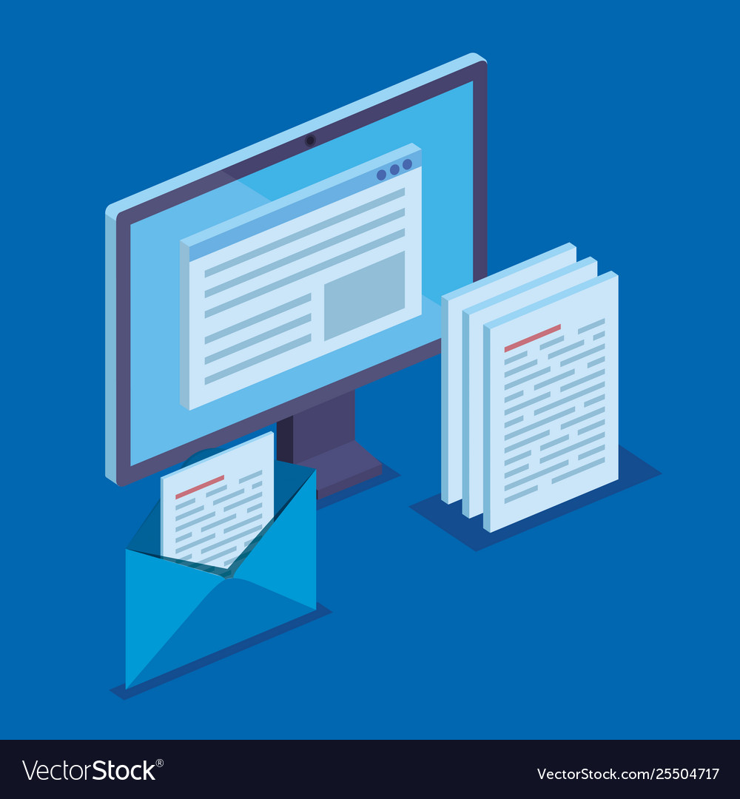
3.SAVE SPACE
Bulky file cabinets are obsolete. A whole cabinet of contents can be condensed into two gigabytes of neatly organized files on a hard drive. Old file rooms can become new offices.

Slide 8
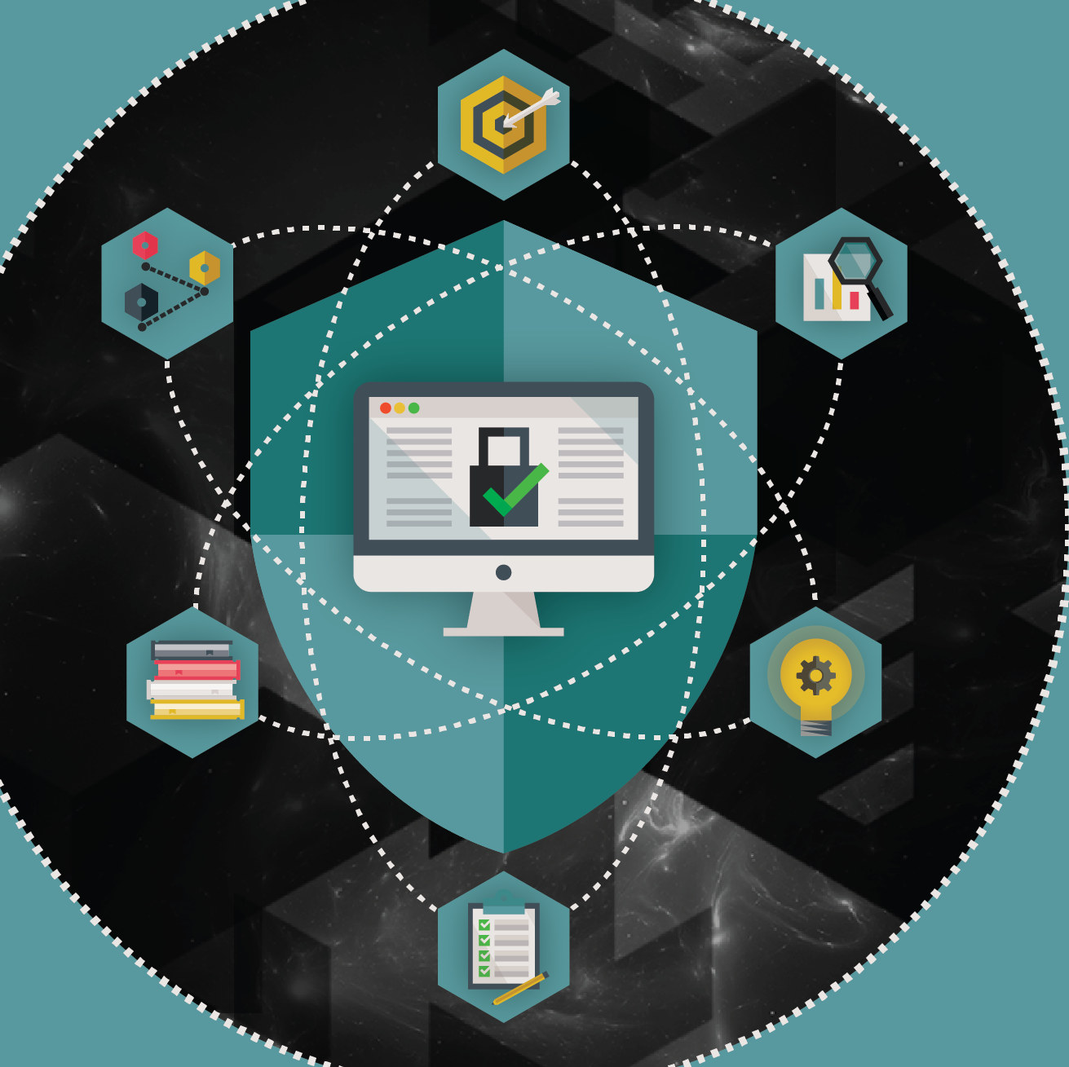
4.IMPROVES SECURITY
Storing and backing up documents on the cloud (online) eliminates the need to carry sensitive papers out of the office. Rigorous safeguards built into back- up systems ensure data is not lost through natural disaster or accident, either

Slide 9
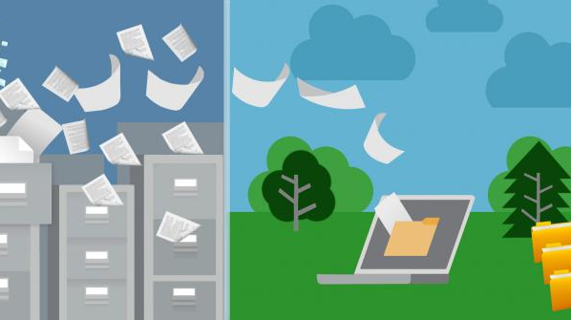
5.BOOSTS CAMPANY IMAGE
Considering that a one terabyte hard drive could possibly save 50,000 trees and that a recent Harris Interactive survey found an increasing number of Americans consider a business’s environmental track record in their purchasing decisions, going paperless may be an ideal way to improve your business image and gain more

Slide 10
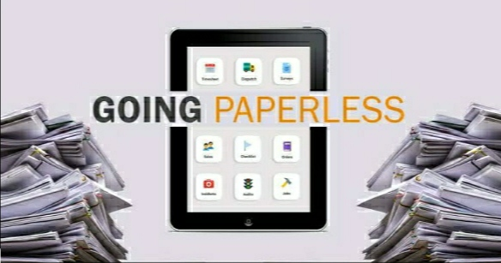
Benefits of going paperless

Slide 11
Getting documents faster.
Saves time and money.
Saving more space in the office.
Getting easier transfer of information.
Promotes the environment.
Boosts security.
Paperless files are easily saved and retrieved on the time.
We have automatic backups.
Helps in Financial benefits.
Receive payments faster.

Slide 12

Protect your company from disasters.
Improves customer service
Copy documents with scanners and phone apps.
Uses E-Mail instead of traditional mail.

Slide 13
*Paperless Office Tools*

Slide 14

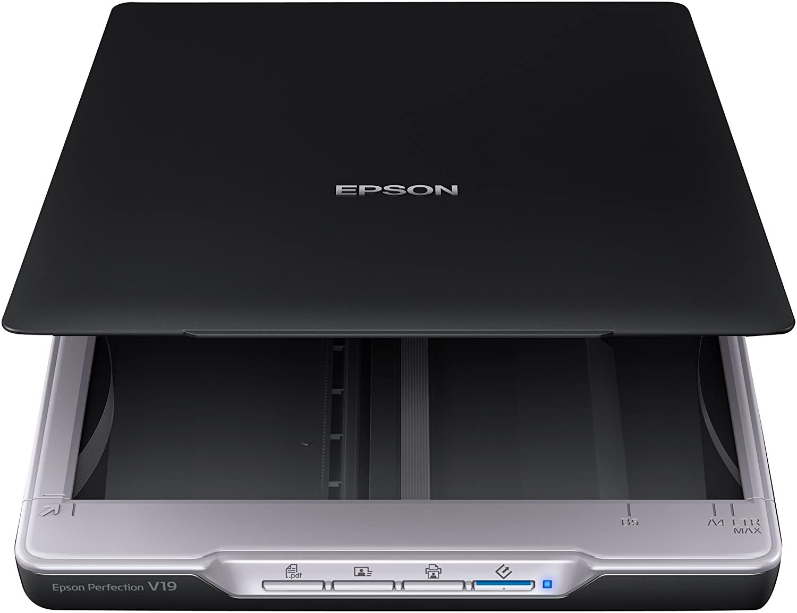
•E-mail :
Email has had the biggest impact, allowing communications to become electronic with the
ability to attach.
• Scanners :
Scanners are one of the most essential tools for a paperless office.

Slide 15

• Software :
Software plays an important role in a paperless office.
Some of such software applications are;
~ NitroPDF.
~ Fax to E-mail Services.
~ EchoSign.
~ Online backup applications.

Slide 16
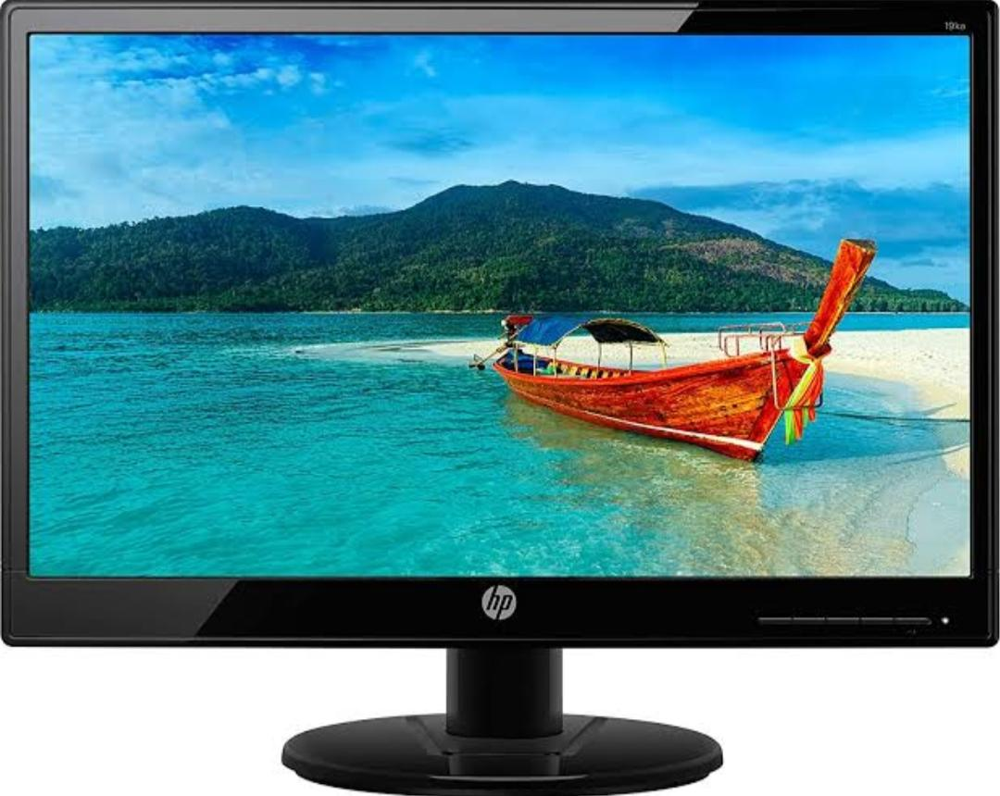


• Displays :
Reading content from a computer screen saves the need to print a paper copy, but some
standard monitors can cause eye strain after extended use.
• Hard Drives :
Eliminating paper copies of documents means risking losing the information they contain in the
event of a computer system crash or hard drive failure.

Slide 17
* What are the obstacles towards a paperless office?

Slide 18
- In spite of many efforts which have been done so far to consume less paper, still large amounts
of paper are used.
- There are also some
technology-related problems on the way towards implementing a paperless office some of
which are as follows;

Slide 19


• Signature :
As we know the scanned from of signatures in many official business relationships and
contracts is not acceptable.
• Reading on screen is difficult:
The second problem is that there are still a large number of people, including people with
eyesight problems and old people, who do not like to read on monitors and prefer to read in
prints.

Slide 20

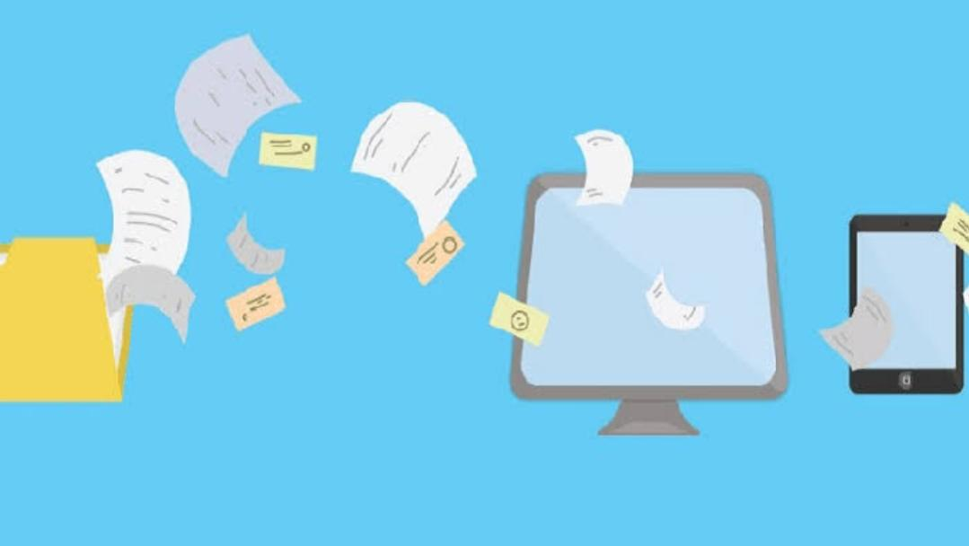
• Risk of data loss :
Another problem is the risk of losing data and document due to software or hardware failure.
• Technology isn’t ready for a paperless office :
While the technology for going paperless is readily available, the rate of adoption for these
tools and this system is quite low.

Slide 21

• Fear :
Although electronic storage is much more secure than having data on paper, some people do
not trust the authenticity or security of online tools.

Slide 22
T
DIFFERENT WAYS TO GO PAPERLESS..
BY: AKHILESH

Slide 23

INTRODUCTION
Very few companies are fully paperless. Though many have started to cut down on processes that use paper, there are still areas where paper is useful and even necessary.
Back then, the technology to take any actionable steps toward a paperless office didn’t exist. The idea of doing business, both personal and professional, without using any paper was a sort of prediction of the future brought about by the invention of computers. The phrase “paperless office” started as a marketing slogan before it could possibly be a reality.
Modern offices have the means to use far less paper. What’s surprising is that statistically, we’re using far more paper. Not only is our consumption higher as a society, but a lot of it is purely wasteful.

Slide 24
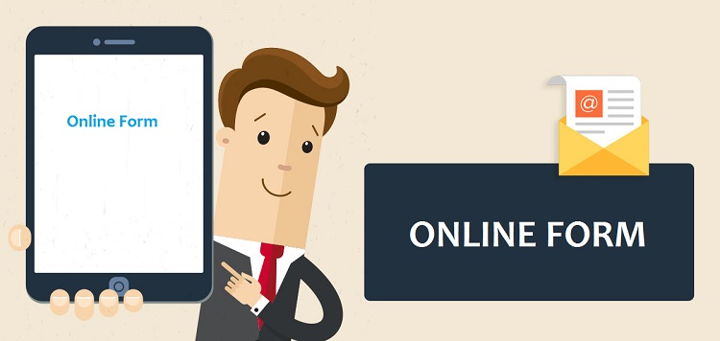
DIFFERENT WAYS TO GO PAPERLESS…..
If you break down the process into steps, it becomes much easier to manage. The challenge gets more manageable with each positive change your organization makes. And going forward, you can choose new digital technologies that don’t involve paper.
Here are a few paperless options:
Online forms: Instead of gathering data with paper forms, use an online form builder, like JotForm. You can customize digital forms for use with both internal and external audiences.

Slide 25
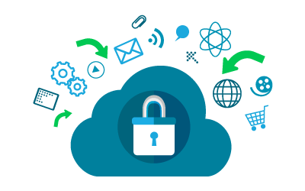
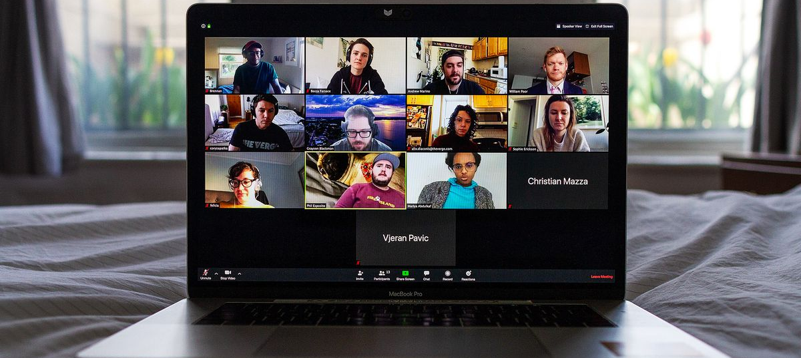
Cloud storage: This is probably one of the most popular options today because it allows all of your team members to stay on the same page and have the same information in real time. It also means that your digital files are saved outside of your office. You can access them from anywhere in the world as long as you have an internet connection.
Scanners: If you have a great deal of documentation to transfer or if you receive a lot of paper from outside companies, you may want to rent or buy a good scanner. Today there are even apps that allow individual employees to scan paper documents when needed and save them to the appropriate place.
Use devices for meetings: Encourage employees to use laptops, tablets, and mobile phones for meetings and other situations where they need to take notes. You can also switch from paper handouts to digital files emailed to each team member in advance

Slide 26
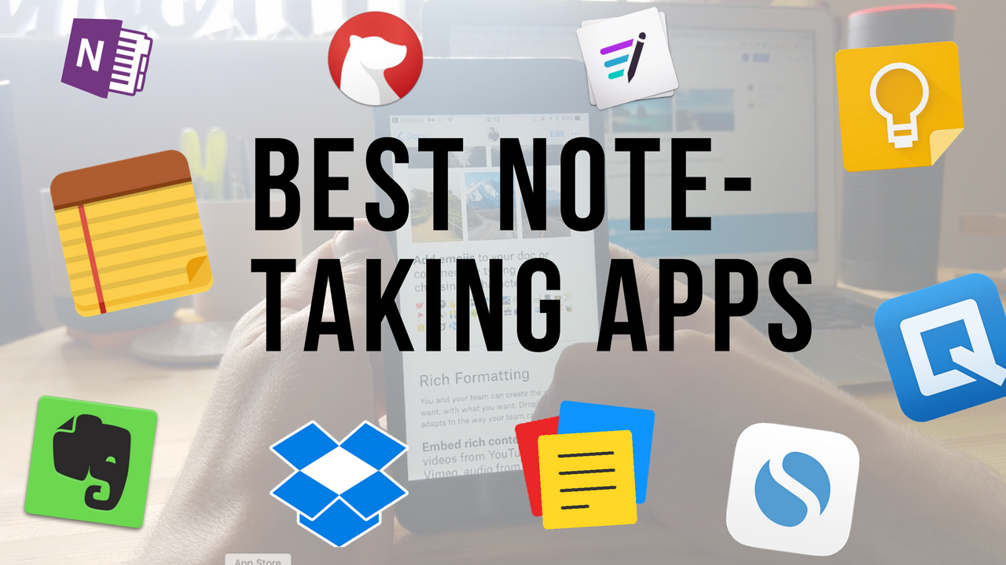
Encourage the use of note-taking apps: Most companies go through a great deal of paper in the form of Post-it notes and legal pads. There is a theory that people learn information better when they hand write it, and we don’t recommend mandating an end to physical note taking. Some employees even brainstorm better while they doodle. It can be worth the trade off to allow for people’s creative processes to function at full steam. Other employees will embrace options to completely digitize their note taking, using apps on their phones or other devices.

Slide 27
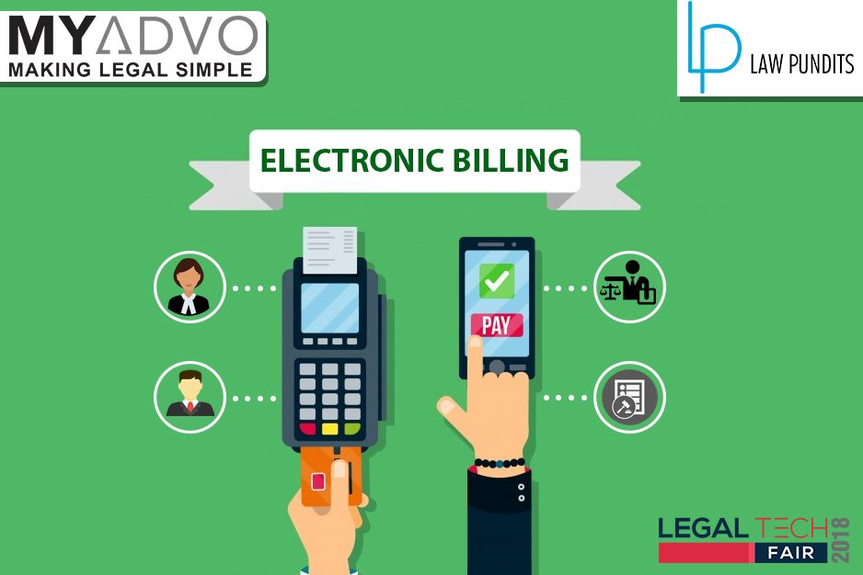
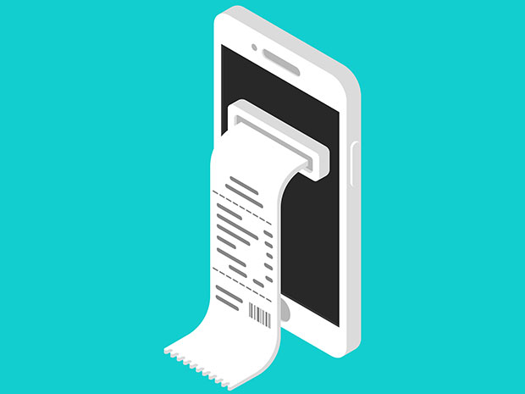
Switch to e-signatures: There’s no legal reason to require paper documents with hand-written signatures at this point. An e-signature is legally binding. Rather than having to fax or mail contracts to each party and wait for them to sign, scan, and email the contract back, or even worse, print out the document, sign it, and mail it back, digital documents can be emailed, completed, returned, and saved, all within a few minutes.
Use electronic billing: Most of your vendors will provide you with the option to switch to electronic billing. Bills can be emailed to your AP/AR department, and payment can be made online, removing the clutter of mailed paper bills and the hassle of writing checks.
Provide digital receipts: If you need to provide receipts to customers as part of your business model, switching to digital receipts is an excellent option. It allows your company and your customers an easy way to save all records without wasting paper.

Slide 28
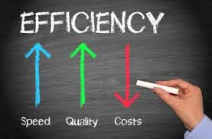

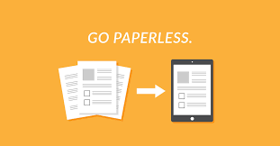
Benefits of Going Paperless
Saves Time. Time spent filing, organizing, and searching for paper documents is time that could be spent on more productive tasks .
Saves Space .
Saves Money .
Eases Transfer of Information .
Promotes the Environment .
Boosts Security .

Slide 29

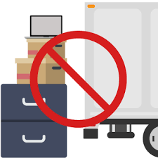

Different ways to go paperless
Online forms. Instead of gathering data with paper forms, use an online form builder, like JotForm .
Cloud storage .
Scanners .
Use devices for meetings .
Encourage the use of note-taking apps .
Switch to e-signatures .
Use electronic billing .
Provide digital receipts .

Slide 30
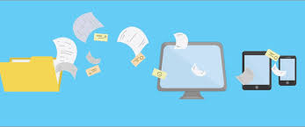
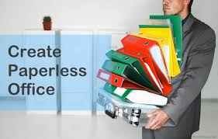
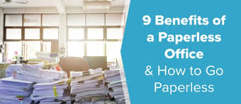
ways to go paperless in the office
1) Take a Stand .
2) Start at reception .
3) Downplay printing .
4) Move to digital financial statements .
5) Encourage recycling and reuse .
6) Find paper alternatives .
7) Reconsider paperless marketing .
8) It's time for electronic signature software .

Slide 31






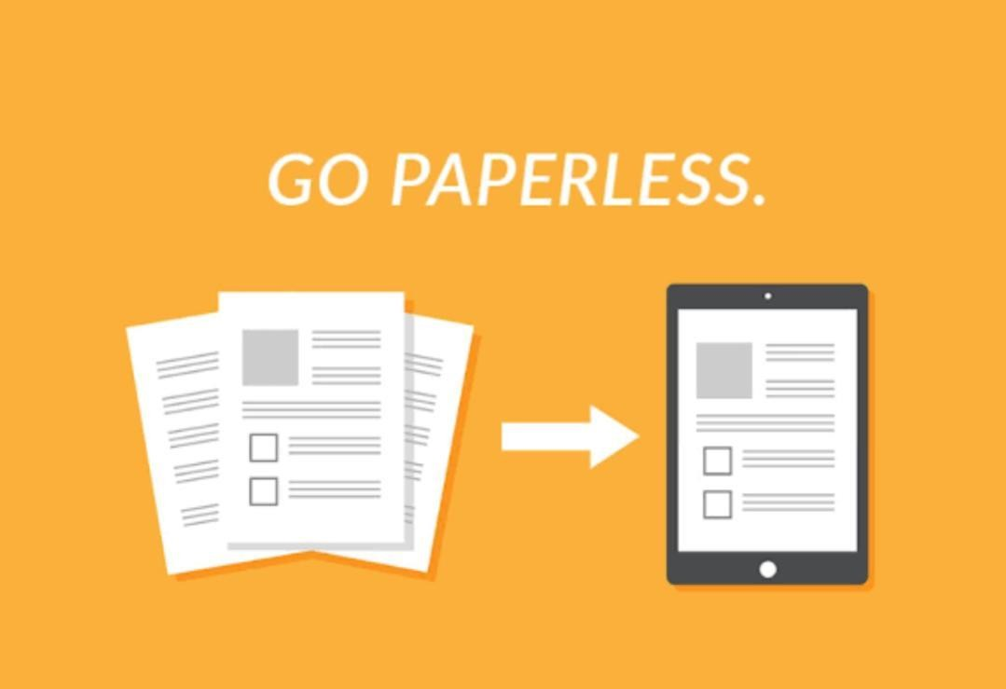




GOING PAPERLESS

Slide 32
ADVANTAGES OF GOING PAPERLESS
Saves time. Times spent filing, organizing And searching for other documents is
time that could be spent on more productive task.
Saves space.
Saves money.
Eases transfer of information.
Promotes the environment.
Boost security.

Slide 33
DISADVANTAGES OF GOING PAPERLESS
There are some disadvantages of going paperless Which still make business cautious including:
Security risk and viruses.
Initial cost.
Difficulties digitializing existing Documents.

Slide 34
STOP USING PAPER
By using less paper, we can reduce our impact on forest.
Cut energy use and Climate change emission, limit water and other pollution and produce less waste.
Using less paper also help ensure We can only use our fair share of the
earth’s resource.

Slide 35
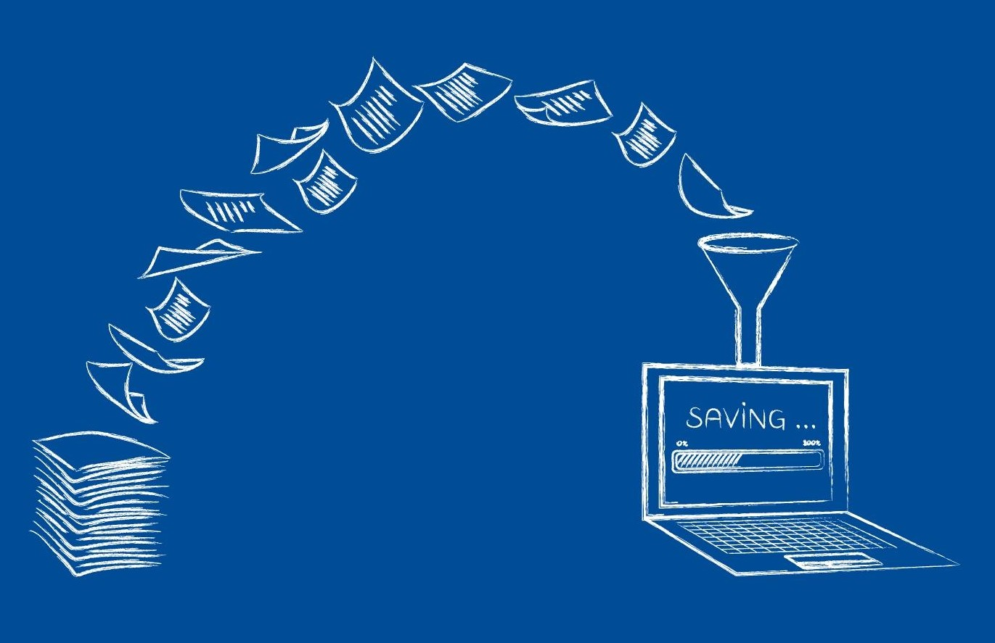

Slide 36









GO PAPERLESS

Slide 37


